Slide 1
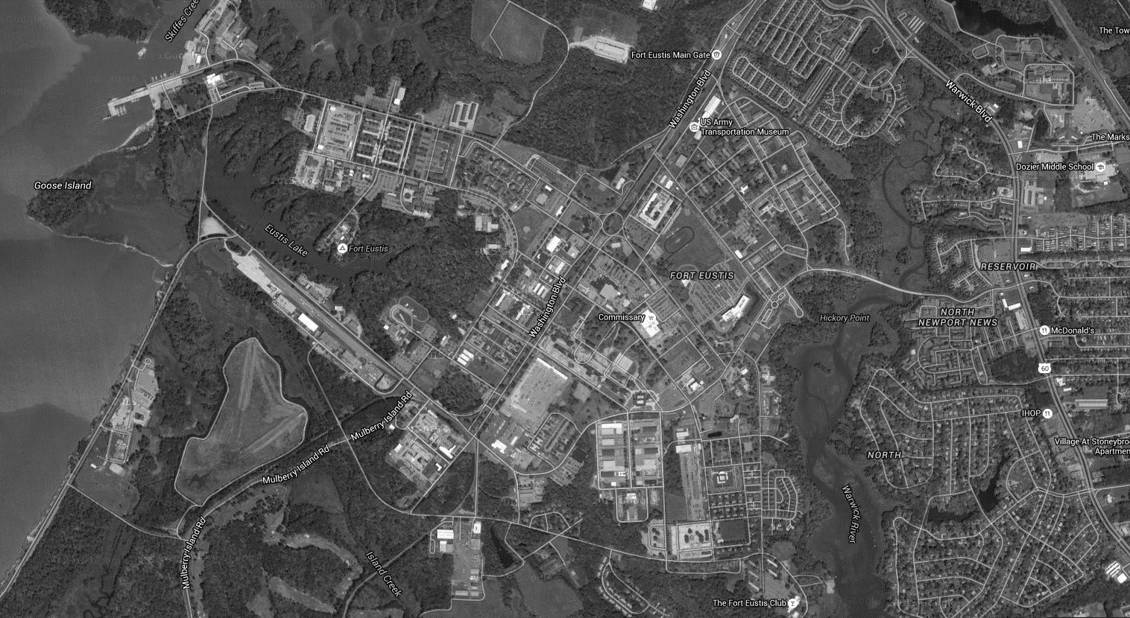
FORT EUSTIS
FACILITY MANAGER PROGRAM

Slide 2
OVERVIEW
733 Civil Engineer Squadron’s mission is to provide fire protection, emergency response, facilities engineering and operations support, infrastructure & real property management, comprehensive land use planning, environmental and housing management for JBLE-Fort Eustis
AFI 32-1001 Operations Management: Requires CE Squadrons to execute and manage a Facility Manager program to standardize guidance and streamline processes to improve customer service and mission execution

Slide 3
733D CIVIL ENGINEER SQUADRON

Slide 4
MODULE 1
FACILITY MANAGER RESPONSIBILITIES

Slide 5
FACILITY MANAGER (FM) APPOINTMENT PROCESS
Must be appointed by unit commander (Battalion or Deputy Brigade level)
Must be E-5+ or above; Civilian equivalent
Must submit a new appointment letter signed by commander at least 30 days prior to deployment, retirement, or separation of assigned FM
Letter must have at least two contact numbers for FMs
Commanders may appoint only one primary and up to two alternate FMs
Commanders may appoint FM or other person, such as Collateral Duty Safety Officer to be Activity Environmental Coordinator (additional duty) as well. This additional duty is not insignificant and should be assigned in light of FM workload

Slide 6
AFI 32-1001
FMs who fail to complete training will not be authorized to initiate work requests or place non-emergency service requests
  Ensure you stay current on the annual requirement for FM training and appointment letters
  POC Sharon Carey, 878-2756, sharon.carey@us.af.mil
The unit commander will ensure all alterations, additions or new construction to facilities are done with CE approval
CE approves all work in real property facilities, regardless of contract method or funding source. (E.g. site approvals, technical approvals, customer funded etc.)

Slide 7
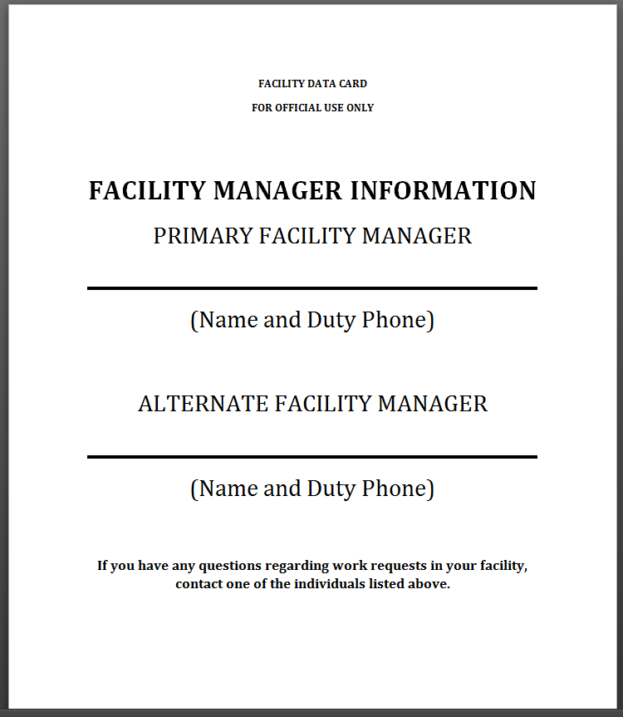
FACILITY MANAGER DATA CARD
Ensures occupants know who their FMs are
Post on ground/each floor of each facility by major entrances.
  Available on CE Webpage:
    https://www.jble.af.mil/Units/Army/733D-Civil-Engineer-Division/

Slide 8
FACILITY MANAGER RESPONSIBILITIES
Provide detailed descriptions of work requirements to Operations Flight for Projects and Customer Service Desk (Service Requests [SRs])
  Vague or incomplete service and project requests will be rejected & require re-submission
Keep a log of all Work Requests (Projects & Service Requests)
  Prevents duplicate requests
Keep Commanders and leadership informed of progress of projects & SRs
  The Base Civil Engineer (BCE) should not be the first CES POC contacted
Ensure building occupants know who the FM is and how to contact you with work requirements

Slide 9
FACILITY MANAGER RESPONSIBILITIES
Hurricanes and Other Inclement Weather
Before event, secure all loose objects outdoors or bring inside if possible
Move GOVs and POVs away from large trees or possible flying debris
If building is subject to flooding, or has a basement, move assets to upper floors or elevate if possible
Secure all facilities (windows and doors) upon leaving and cover sensitive equipment that may be damaged by intruding water
After inclement weather (e.g. wind, hurricane), ensure a visual inspection of facilities for incident damage (tree/wind damage) is completed in a timely and safe manner
  Including when installation is operating under limited conditions, OR if installation is open on weekends
Report all damage and outages to CES at 878-5225/4357. Call 9-1-1 if it is an emergency

Slide 10
FACILITY MANAGER RESPONSIBILITIES
Snow & Cold Weather
Before event, make sure heat is operational, and faucets are on a drip if applicable
Consolidate GOVs in one corner of parking lot for plowing
Removal of snow/ice from entrance ways & sidewalks (300’ radius)
  Sand and Salt will be stockpiled in the CES compound and available for pickup upon notification
    BYOB – Bring your own Bucket, Shovel, and GOV…No truckloads, No dump trucks
After inclement weather, ensure a visual inspection of facilities for damage (frozen pipes, leaks, tree/wind damage) is completed in a timely and safe manner
  Including when installation is operating under limited conditions, OR if installation is open on weekends
JBLE Snow/Ice Removal Plan is available at https://www.jble.af.mil/Units/Army/733D-Civil-Engineer-Division/

Slide 11
MODULE 2
HOW WORK GETS DONE

Slide 12
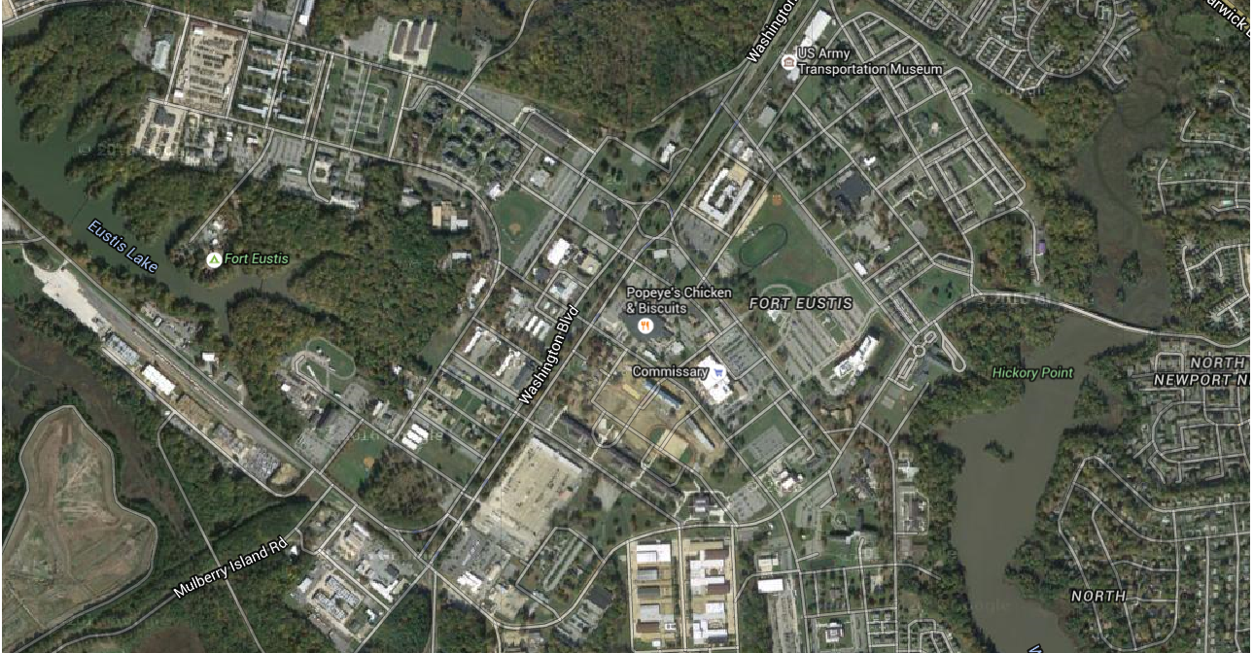
733 CES BUILDING 1407 Location

Slide 13
BASE MAINTENANCE CONTRACTOR (BMC) SERVICES
Instead of Shops, JBLE-Eustis has a BMC
BMC incorporates all shop functions for CES and executes the following:
  Preventative maintenance on facility equipment
  Pesticide application, severe weather response, service requests
  Generator operations and maintenance
  Swimming pool maintenance
BMC does not handle paint work more than 200 SF. Paint work more than 200 SF is handled through the Paint IDIQ Contract
  Contracting Officer Representative (COR) for BMC –
    Desiree McHan, 878-7369, desiree.mchan@us.af.mil
    Michael Johnson, 878-3625, michael.johnson.419@us.af.mil

Slide 14
WORK REQUEST CATEGORIES
Recurring Work (Preventative Maintenance)
Service Requests
Project Requests
  Operations Projects
Projects (Engineering)

Slide 15
WORK REQUEST CATEGORIES
Recurring Work (Preventative Maintenance)
  Scope and level of effort is predetermined
  All recurring work necessary to prevent breakdown of critical facilities, equipment, or utilities
  Examples Include - Storm drain cleaning, BMP maintenance, elevator inspection, replacing filters, generator testing

Slide 16
SERVICE ORDERS
FMs & Building POCs should submit Service Requests in NexGen. If NexGen is unavailable, you may submit by calling or visiting building 1407, room 105.
  Record Service Request number to facilitate follow-up and ensure completion
  ALWAYS CALL 9-1-1 FOR EMERGENCIES
  ANYONE may place EMERGENCY Service Orders - Please make sure all building occupants know their building number
Customer Service Desk - 878-5225 / 878-4357
  Hours of Operation: Mon-Fri, 0700-1700
Emergency After-Hours - 878-5225/4357 - redirects to Fire Dispatch
  Include all relevant information: Bldg#, POC name/number, Detailed Description, etc
  DO NOT submit emergency Service Requests in NexGen…always call for emergency/urgent matters

Slide 17
WORK REQUEST CATEGORIES
Service Request (SR) Priorities
  Priority 1- Emergency SR
    30 min after being notified / 2 hours during non-business days
    Repair work will continue until condition has been corrected or stabilized
    Examples – leaking roof with ongoing damage, refrigerator breakdown at DFAC, no A/C or heat in the building (not individual offices) etc.
  Priority 3A (High) – Scheduled Sustainment Work (High)
    Work scheduled within 2 business days of request, 5 business days to completion
    Corrective maintenance projects with a high return of investment (ROI)
    If work cannot be completed in timeframe COR will be notified for extension
    Examples – Perimeter fencing, street lighting at intersection, repair Exterior Security Lights

Slide 18
WORK REQUEST CATEGORIES
  Service Request (SR) Priorities (cont’d)
    Priority 3B Medium – Time sensitive corrective maintenance work
      Work scheduled within 5 business days of receipt, 30 day completion
      Examples: Ceiling tile replacement, changing broken fixtures and door handles, etc
    Priority 3C Low – Corrective maintenance work
      Work scheduled within 5 business days of receipt, 30 day completion
      Examples: Installation of informational signs, tree limb removal, etc
      .

Slide 19
REIMBURSABLE BMC CONTRACT PROJECTS
The BMC contract has a limited monetary capacity to execute reimbursable work larger than the scope of Service Requests
Reimbursable projects that do not receive funding within 45 days of the initial request for funding will be placed on hold
Projects which have a defined and firm Statement of Work (SOW) with funding in hand will be prioritized ahead of projects without

Slide 20
Module 3
OPERATIONS FLIGHT

Slide 21
SERVICE CONTRACTS
CUSTODIAL
REFUSE
GROUNDS MAINTENANCE
  Facility Managers report potential deficiencies to contract CORs

Slide 22
CUSTODIAL
Primary COR -
Alternate – Aviance Jenkins, 878-7385, aviance.jenkins@us.af.mil
Restroom cleaning only
  Level 1 Facilities Monday – Wednesday – Friday
  Level 2 Facilities Tuesday – Thursday
Paper and soap products for restroom use only
Restroom trash containers are for restroom generated trash only
Facility Cleanings include sweeping, mopping, vacuuming services
  Level 1 Facilities - one time weekly
  Level 2 Facilities - once every two weeks
Each building needs a centralized location to place trash for collection
  No desk-side trash collection and trash bags are not provided

Slide 23
REFUSE/RECYCLING
COR Aviance Jenkins, 878-7385, aviance.jenkins@us.af.mil
Alternate – Janice McGhee, 878-5466 - janice.mcghee@us.af.mil
Single Stream recycling pickup Tuesday- place containers out Monday night
  Drivers start at 0400
Cardboard containers are serviced Tuesday and/or Friday
  You can bring cardboard to the recycle center where it is crushed and baled
Place shredded paper in clear plastic bags by recycle containers
  Do not shred CDs, Credit cards, plastic coated paper or envelopes with the clear plastic window
Toner will not be picked up if in or on top of recycle containers
  All toner cartridges must be placed in the box the replacement came in/clear plastic bag & taken to recycling center

Slide 24
REFUSE/RECYCLING (cont’d)
Please deliver large items to the recycling center or contact CE for assistance
Normal Operating Hours: 0730-1500, M-W-F, B1209
Recycle used oil, oil filters & empty oil cans at the recycle center
Recycle has a commercial shredder and a classified & higher class shredder
  Call for appointment at 878-4232
NOT recyclable - Oil cans, paint buckets, aerosol cans, and other chemical containers
  They should be taken to the Haz Waste Storage Facility B 1207/8

Slide 25
GROUNDS MAINTENANCE
COR Janice McGhee, 757-298-0865, janice.mcghee@us.af.mil
Alternate – Mike Johnson, 826-3625, michael.johnson.419@us.af.mil
Lawn maintenance
  Vegetation height maintained varies
    Improved Grounds – 2”-4” (includes edging/trimming)
    Semi-improved Grounds (Non-Airfield) – 4”-10”
    BASH Area – 7”-14”
Growing Season is March-October
Facility managers are responsible for maintaining vegetative beds, shrubs, weeding, mulching, and pruning within 50 feet of their facilities

Slide 26
SERVICE CONTRACTS
( Railroad, Elevator, Crane and Hoist Services)
Railroad Services –
Primary: Aviance Jenkins, 878-7385, aviance.jenkins@us.af.mil
Alternate:
  Maintains all tracks and crossing signals
  Pesticides application on tracks
Elevator Services –
Primary: Janice McGhee, 757-298-0865 - janice.mcghee@us.af.mil
Alt: Aviance Jenkins, 878-7385, aviance.jenkins@us.af.mil
  Maintenance of the elevators on post
  Executes annual inspection and certification
  Note: if entrapment occurs in an elevator call 9-1-1
Crane and Hoist Services –
Primary: Janice McGhee, 757-298-0865 - janice.mcghee@us.af.mil
Alt:
Maintains all Cranes and Hoists with exception of the Hagglund Crane at the Army Transportation School
  Execute routine inspection and certification

Slide 27
PROJECT REQUESTS
  Minor construction, major maintenance/repair or new work that requires detailed planning or modification of facility
    Definition of these categories is not always intuitive
  Facility Manager is the only one authorized to submit Project Requests
  Initiates Work Orders, Projects, or Contract by Requester with Technical Approval
  It is extremely beneficial to have your organization’s Top 10 Priorities ready to provide to CES when requested

Slide 28
PROJECT REQUEST CATEGORIES
Facility Projects
  FM must submit a request through NexGen
  Project-oriented work such as modifications, total replacements and new work that are beyond the Service Request criteria
  Facility Projects can vary significantly in nature and scope and may involve multiple crafts and locations
  Significant investment of time, labor, or money
  Accomplished through various contracts (see Engineering Project Contracting Avenues slide)
Contract by Requester
  Facility Managers must also submit Project Requests to accomplish work themselves
  Contract by requester or Self Help
  These requests require Technical Approval by CES
  Customer GPC used to accomplish work

Slide 29
WORK REQUEST MANAGEMENT
(Project Requests)
Submit in NexGen
Provide detailed Description & Justification
  Attach any pertinent safety write-ups, photos, area maps, drawings, designs, sketches
  Vague or incomplete requests will be rejected

Slide 30

WORK REQUEST PROCESS
  Projects may be reviewed by all CES Flights…Operations, Engineering, Real Property, Environmental, Fire Department
Submit Project Request
Reviews & Assignment
Funding
Begin Work

Slide 31

WORK GROUPS & REVIEW BOARDS
  FMs will be notified if a project they requested is being reviewed so that they can actively participate
  Flights review Project Requests and determine execution method

Slide 32
POCs
Service Order Desk, 1407 Washington Blvd
  Mon-Fri, 0700-1700
  878-5225 / 878-4357
  After Hours – phones automatically forward to Fire Dispatch
Work Request Management
  danielle.quinlan@us.af.mil – 878-7360
  sharon.carey@us.af.mil – 878-2756

Slide 33
Module 4
ENERGY MANAGEMENT

Slide 34
ENERGY MANAGEMENT PLAN
Reduce Facility Energy Use 2.5% per year to 2025 (Baseline 2015)
Reduce Base Water Use 2% per year to 2025 (Baseline 2007)
25% of total energy (electric and thermal) will come from clean sources by 2025 (at least 30% of the electricity portion of total energy will be obtained from renewable sources)
Reduce Ground Vehicle fuel use 2% per year
Increase Alternative Fuel use 10% per year
Executive Order 13834 revokes Executive Order 13693 but using guideline until new goals are established

Slide 35
ENERGY MANAGEMENT
(Energy Conservation)
Cost of utilities required to operate Ft. Eustis for ONE day.
Utilities - $33,403.19
  Natural Gas $4,636.98
  Electricity - $21,403.76
  Fuel Oil - $148.11
  Propane - $45.47
  Water and Wastewater - $7,168.85
  Total FY 18 Utility Bill - $12,025,151.73
  Total FY 17 Utility Bill - $11,591,955.68

Slide 36
HVAC SET POINTS
Heating:
  Heating turned on when average high air temperature drops to 55 °F for 4 consecutive days
Thermostat Set Points:
  Admin Spaces: Occupied – 70 °F // Unoccupied: 55 °F
  Shop Spaces: Occupied - 65 °F // Unoccupied 55 °F
  Warehouse Spaces: Occupied - 60 °F // Unoccupied 55 °F
Cooling:
  AC turned on when average high air temperature reaches 75 °F for 4 consecutive days
Thermostat Set Points:
  Admin Spaces: Occupied – 73 °F // Unoccupied - 80 °F
  Shop Spaces: Occupied - 76 °F // Unoccupied – 80 °F
  Warehouse Spaces: Not required unless authorized for perishable items

Slide 37
ENERGY MANAGEMENT
(Energy Conservation Plan)
Consolidate refrigerators and coffee pots to central break areas
No space heaters unless approved by CE Operations for legitimate health reason
Turn off lights in unoccupied spaces
Turn off computer monitors and peripherals at end of duty day
Turn off printers, copiers, scanners and other office equipment at end of duty day
Dress appropriately for personal comfort
Establish, maintain and maximize use of Energy Management Systems (EMCS, SCADA, etc.) to centrally monitor and control utility and building systems
Prohibit use of potable water for landscape irrigation systems

Slide 38
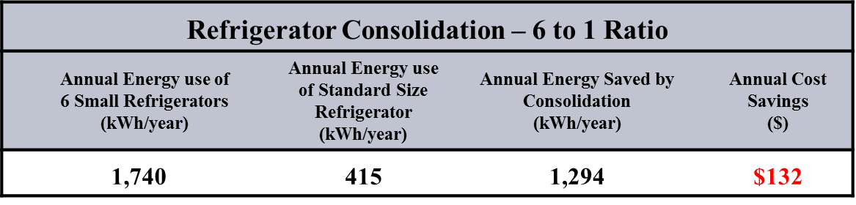
ENERGY MANAGEMENT
(Energy Conservation Plan- contd.)
REFRIGERATORS
  Reduce the number of personal refrigerators, coffee makers and microwaves in facilities and consolidate appliances in designated break areas. Validate the necessity of every refrigerator, coffee maker and microwave and consolidate break areas to the maximum extent possible

Slide 39
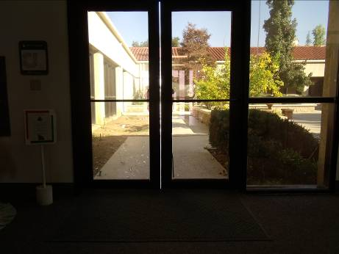
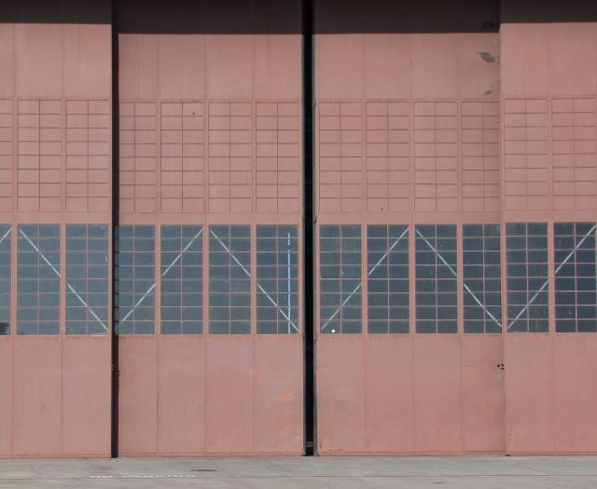
ENERGY MANAGEMENT
(Envelope Opportunities)
Close Doors
Fix weather-stripping

Slide 40
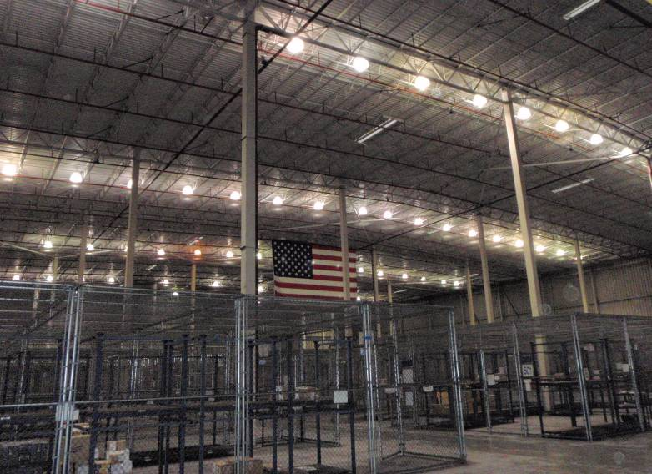
Lights are on, but nobody is home

Slide 41
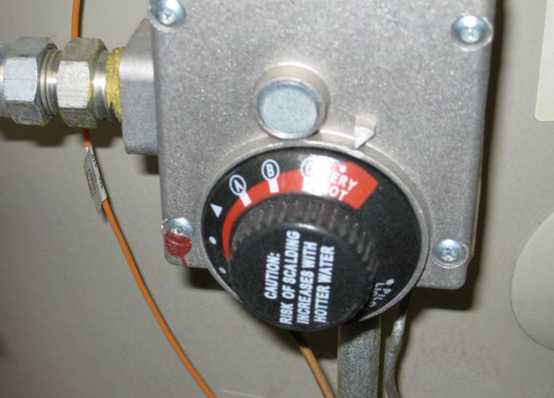
Do you need very hot?
Building occupants should not tamper with water heaters
FMs can place a service order to have their water heaters turned down

Slide 42
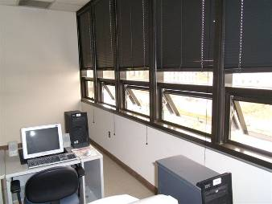
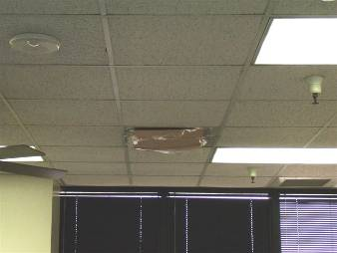
Do Not…
Block air diffusers
Open windows, exterior doors
Invitation for MOLD

